Slide 1
Mathematics for AI
Adams Wai Kin Kong
School of Computer Science and Engineering
Nanyang Technological University, Singapore
adamskong@ntu.edu.sg
Copyright © Cengage Learning. All rights reserved.

Slide 2
The Chain Rule

Slide 3

The Chain Rule
We know that the Chain Rule for functions of a single variable gives the rule for differentiating a composite function: If y = f (x) and x = g(t), where f and g are differentiable functions, then y is indirectly a differentiable function of t and
For functions of more than one variable, the Chain Rule has several versions, each of them giving a rule for differentiating a composite function.

Slide 4
The Chain Rule
The first version (Theorem 2) deals with the case where z = f (x, y) and each of the variables x and y is, in turn, a function of a variable t.
This means that z is indirectly a function of t, z = f (g(t), h(t)), and the Chain Rule gives a formula for differentiating z as a function of t. We assume that f is differentiable.

Slide 5
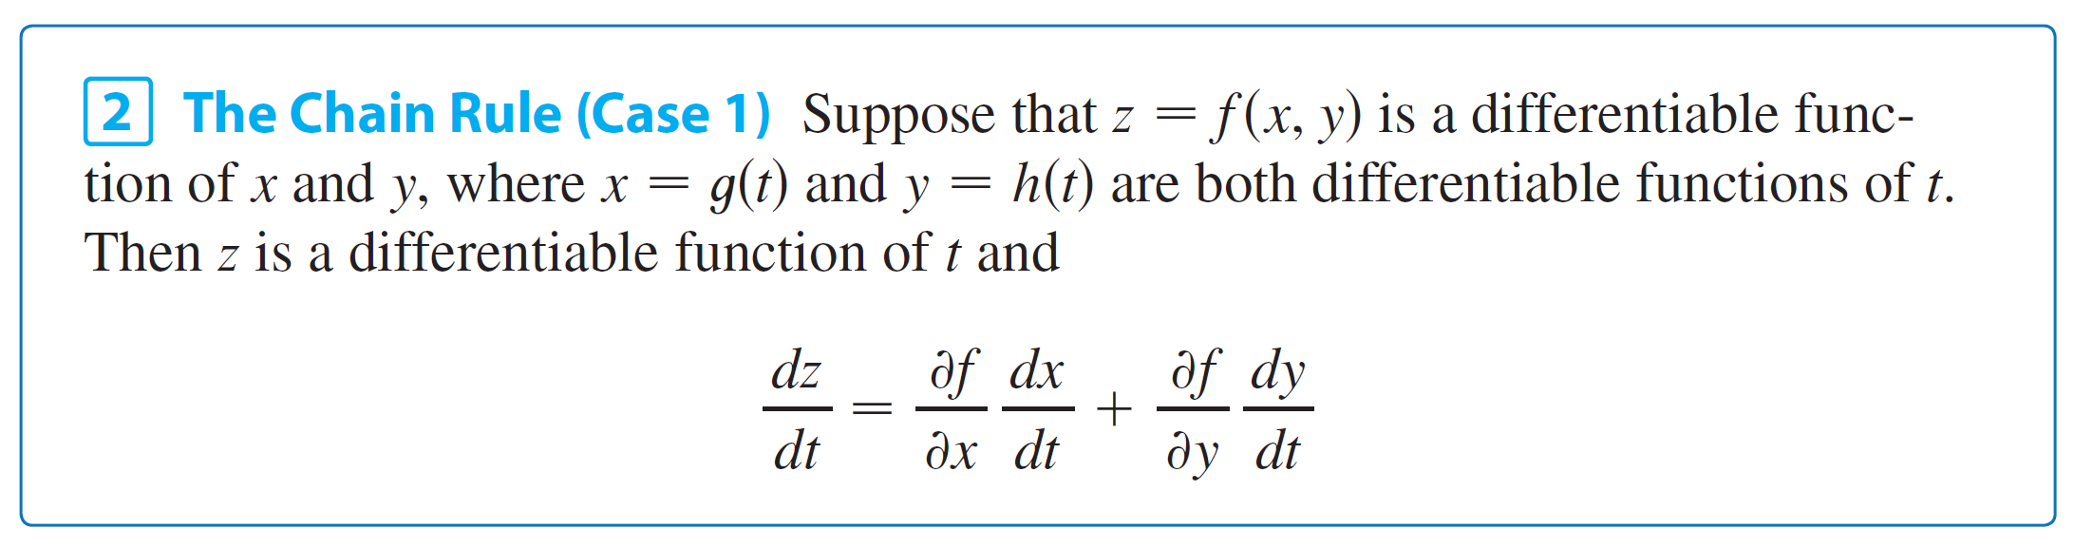
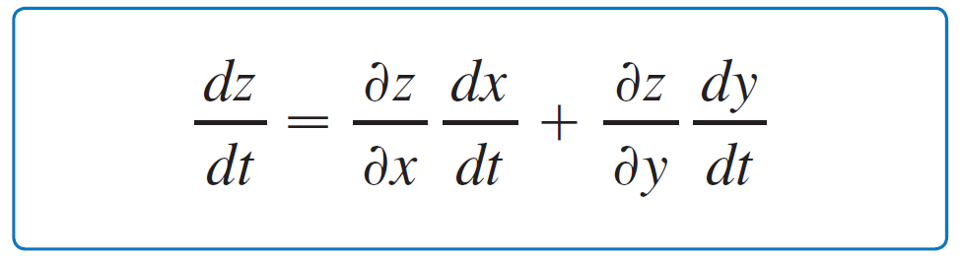
The Chain Rule
We know that this is the case when f_{x} and f_{y} are continuous.
Since we often write ∂z/∂x in place of ∂ f /∂x, we can rewrite the Chain Rule in the form

Slide 6
Example 1
If z = x²y + 3xy⁴, where x = sin 2t and y = cos t, find dz/dt when t = 0.
Solution:
The Chain Rule gives
It’s not necessary to substitute the expressions for x and y in terms of t.

Slide 7
Example 1 – Solution
We simply observe that when t = 0, we have x = sin 0 = 0 and y = cos 0 = 1.
Therefore

Slide 8
The Chain Rule
We now consider the situation where z = f (x, y) but each of x and y is a function of two variables s and t: x = g(s, t), y = h(s, t).
Then z is indirectly a function of s and t and we wish to find ∂z /∂s and ∂z /∂t.
We know that in computing ∂z /∂t we hold s fixed and compute the ordinary derivative of z with respect to t.
Therefore we can apply Theorem 2 to obtain

Slide 9
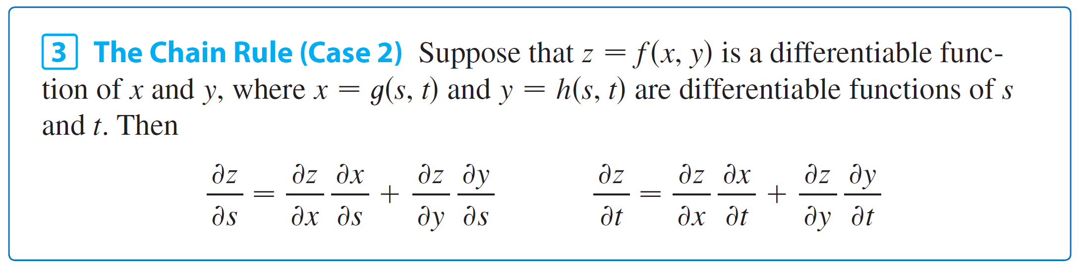
The Chain Rule
A similar argument holds for ∂z /∂s and so we have proved the following version of the Chain Rule.
Case 2 of the Chain Rule contains three types of variables: s and t are independent variables, x and y are called intermediate variables, and z is the dependent variable.

Slide 10
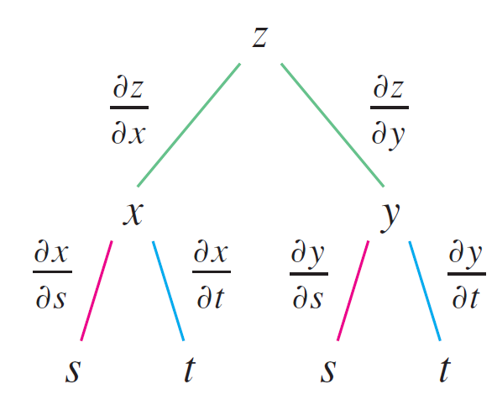
The Chain Rule
Notice that Theorem 3 has one term for each intermediate variable and each of these terms resembles the one-dimensional Chain Rule in Equation 1.
To remember the Chain Rule, it’s helpful to draw the tree diagram in Figure 2.
Figure 2

Slide 11
The Chain Rule
We draw branches from the dependent variable z to the intermediate variables x and y to indicate that z is a function of x and y. Then we draw branches from x and y to the independent variables s and t.
On each branch we write the corresponding partial derivative. To find ∂z /∂s, we find the product of the partial derivatives along each path from z to s and then add these products:

Slide 12
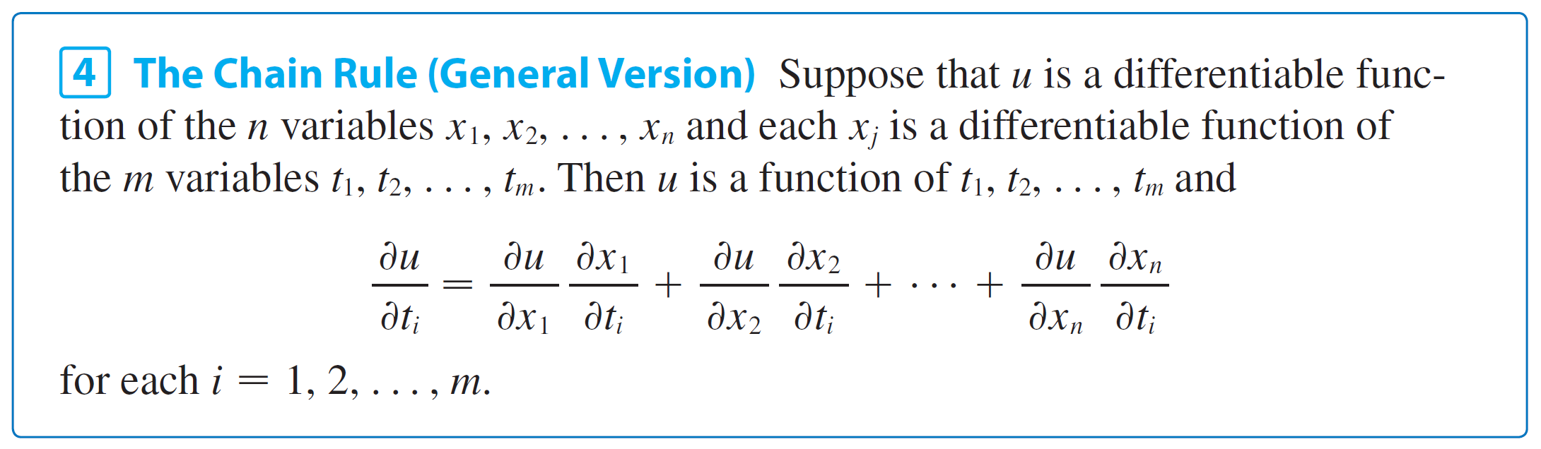
The Chain Rule

Slide 13
Implicit Differentiation
The Chain Rule can be used to give a more complete description of the process of implicit differentiation.
We suppose that an equation of the form F (x, y) = 0 defines y implicitly as a differentiable function of x, that is, y = f (x), where F (x, f (x)) = 0 for all x in the domain of f.
If F is differentiable, we can apply Case 1 of the Chain Rule to differentiate both sides of the equation F (x, y) = 0 with respect to x.
Since both x and y are functions of x, we obtain

Slide 14
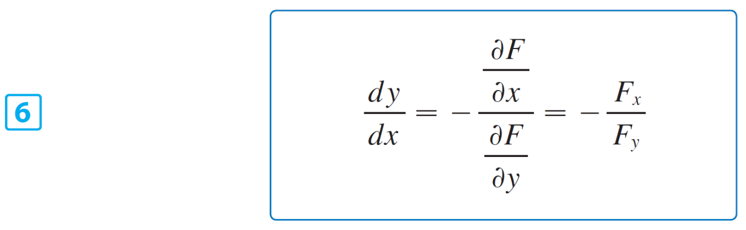
Implicit Differentiation
But dx /dx = 1, so if ∂F /∂x ≠ 0 we solve for dy /dx and obtain
To derive this equation we assumed that F (x, y) = 0 defines y implicitly as a function of x.

Slide 15
Implicit Differentiation
The Implicit Function Theorem, proved in advanced calculus, gives conditions under which this assumption is valid: it states that if F is defined on a disk containing (a, b), where F (a, b) = 0, F_{y}(a, b) ≠ 0, and F_{x} and F_{y} are continuous on the disk, then the equation F (x, y) = 0 defines y as a function of x near the point (a, b) and the derivative of this function is given by Equation 6.

Slide 16
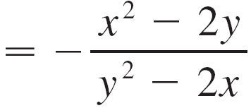
Example 8
Find y ′ if x³ + y³ = 6xy.
Solution:
The given equation can be written as
F (x, y) = x³ + y³ – 6xy = 0
so Equation 6 gives

Slide 17
Implicit Differentiation
Now we suppose that z is given implicitly as a function z = f (x, y) by an equation of the form F (x, y, z) = 0.
This means that F (x, y, f (x, y)) = 0 for all (x, y) in the domain of f. If F and f are differentiable, then we can use the Chain Rule to differentiate the equation F (x, y, z) = 0 as follows:

Slide 18
Implicit Differentiation
But and
so this equation becomes
If ∂F /∂z ≠ 0, we solve for ∂z /∂x and obtain the first formula in Equations 7.
The formula for ∂z /∂y is obtained in a similar manner.

Slide 19
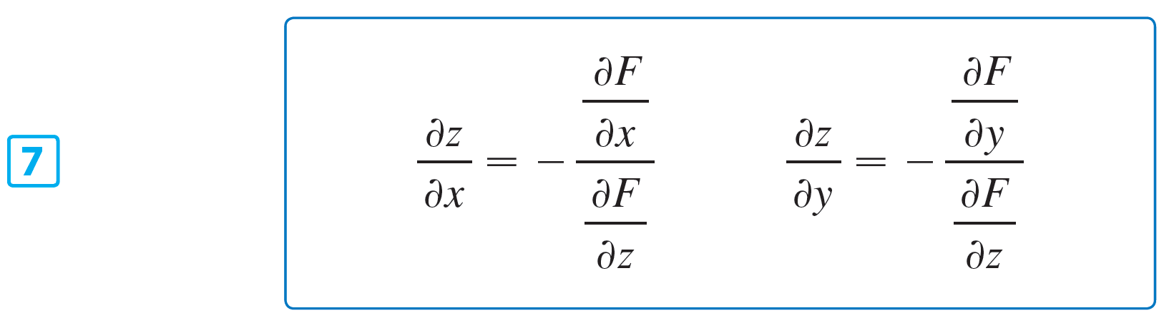
Implicit Differentiation
Again, a version of the Implicit Function Theorem stipulates conditions under which our assumption is valid: if F is defined within a sphere containing (a, b, c), where F (a, b, c) = 0, F_{z} (a, b, c) ≠ 0, and F_{x}, F_{y}, and F_{z} are continuous inside the sphere, then the equation F (x, y, z) = 0 defines z as a function of x and y near the point (a, b, c) and this function is differentiable, with partial derivatives given by (7).

Slide 20
Directional Derivatives

Slide 21

Directional Derivatives
Recall that if z = f (x, y), then the partial derivatives f_{x} and f_{y} are defined as
and represent the rates of change of z in the x- and y-directions, that is, in the directions of the unit vectors i and j.

Slide 22
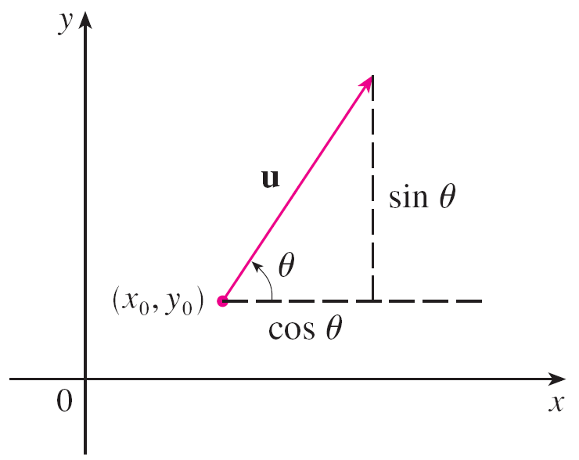
Directional Derivatives
Suppose that we now wish to find the rate of change of z at (x₀, y₀) in the direction of an arbitrary unit vector u = ⟨a, b⟩.
(See Figure 1.)
To do this we consider the surface S with the equation z = f (x, y) (the graph of f) and we let z₀ = f (x₀, y₀). Then the point P(x₀, y₀, z₀) lies on S.
A unit vector u = ⟨a, b⟩ = ⟨cos u, sin u ⟩
Figure 1

Slide 23
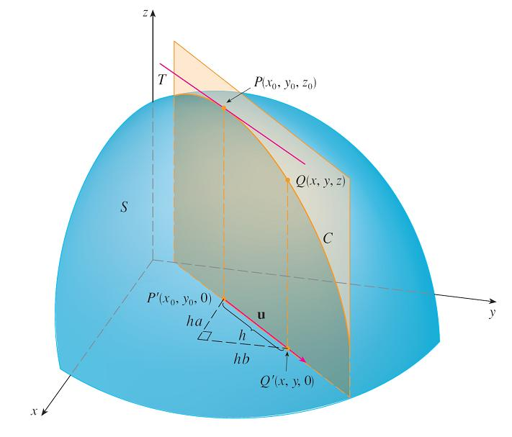
Directional Derivatives
The vertical plane that passes through P in the direction of u intersects S in a curve C. (See Figure 2.)
Figure 2

Slide 24
Directional Derivatives
The slope of the tangent line T to C at the point P is the rate of change of z in the direction of u.
If Q(x, y, z) is another point on C and P′, Q′ are the projections of P, Q onto the xy-plane, then the vector is parallel to u and so
= hu = ⟨ha, hb⟩
for some scalar h. Therefore x – x₀ = ha, y – y₀ = hb, so x = x₀ + ha, y = y₀ + hb, and

Slide 25
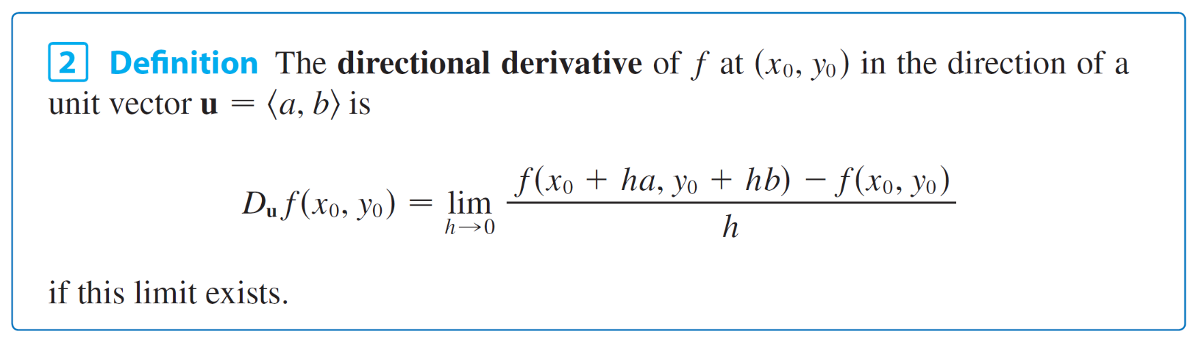
Directional Derivatives
If we take the limit as h → 0, we obtain the rate of change of z (with respect to distance) in the direction of u, which is called the directional derivative of f in the direction of u.

Slide 26
Directional Derivatives
By comparing Definition 2 with Equations 1, we see that if u = i = ⟨1, 0⟩, then D_{i}f = f_{x} and if u = j = ⟨0, 1⟩, then D_{j}f = f_{y}.
In other words, the partial derivatives of f with respect to x and y are just special cases of the directional derivative.

Slide 27
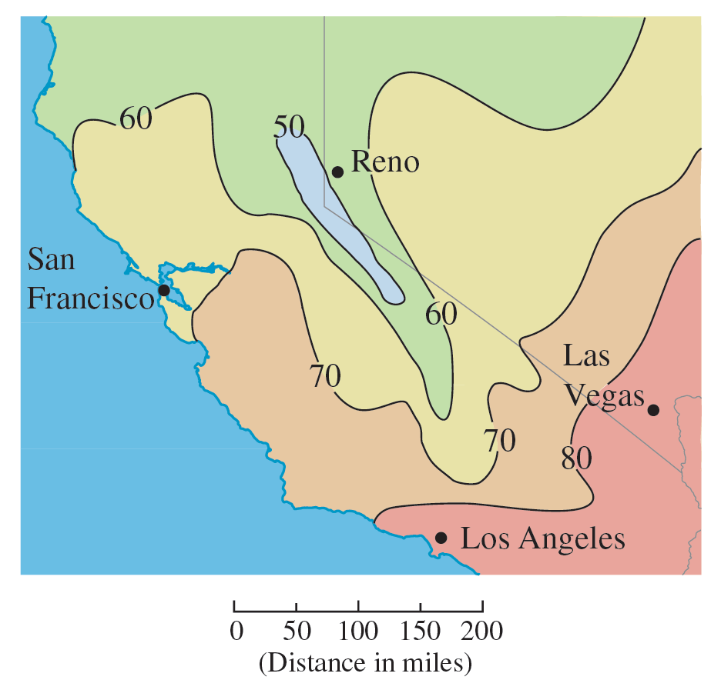
Example 1
Use the weather map in Figure 3 to estimate the value of the directional derivative of the temperature function at Reno in the southeasterly direction.
Figure 3

Slide 28
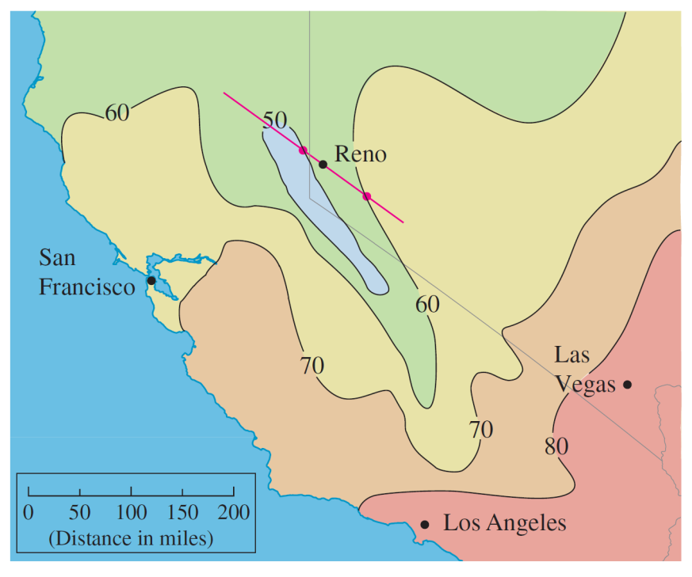
Example 1 – Solution
The unit vector directed toward the southeast is but we won’t need to use this expression.
We start by drawing a line through Reno toward the southeast (see Figure 4).
Figure 4

Slide 29

Example 1 – Solution
We approximate the directional derivative D_{u}T by the average rate of change of the temperature between the points where this line intersects the isothermals T = 50 and T = 60.
The temperature at the point southeast of Reno is T = 60°F and the temperature at the point northwest of Reno is T = 50°F.
The distance between these points looks to be about 75 miles. So the rate of change of the temperature in the southeasterly direction is

Slide 30
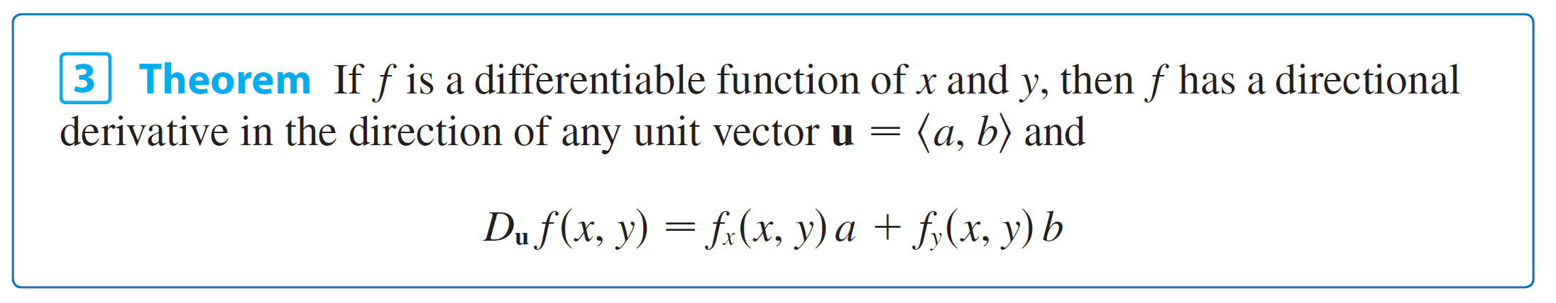
Directional Derivatives
When we compute the directional derivative of a function defined by a formula, we generally use the following theorem.

Slide 31

Directional Derivatives
If the unit vector u makes an angle θ with the positive x-axis (as in Figure 2), then we can write u = ⟨cos θ, sin θ ⟩ and the formula in Theorem 3 becomes
D_{u}f (x, y) = f_{x}(x, y) cos θ + f_{y}(x, y) sin θ
A unit vector u = ⟨a, b⟩ = ⟨cos u, sin u ⟩

Slide 32

The Gradient Vector
Notice from Theorem 3 that the directional derivative of a differentiable function can be written as the dot product of two vectors:
D_{u}f (x, y) = f_{x}(x, y)a + f_{y}(x, y)b
= ⟨f_{x}(x, y), f_{y}(x, y)⟩  ⟨a, b⟩
= ⟨f_{x}(x, y), f_{y}(x, y)⟩  u
The first vector in this dot product occurs not only in computing directional derivatives but in many other contexts as well.
So we give it a special name (the gradient of f ) and a special notation (grad f or ∇f, which is read “del f ”).

Slide 33
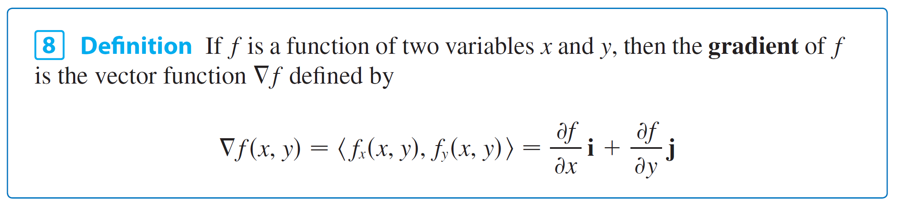
The Gradient Vector
Example 3: If f (x, y) = sin x + e^{xy}, then
∇f (x, y) = ⟨f_{x}, f_{y}⟩ = ⟨cos x + ye^{xy}, xe^{xy}⟩
and ∇f (0, 1) = ⟨2, 0⟩

Slide 34

The Gradient Vector
With the notation for the gradient vector, we can rewrite Equation 7 for the directional derivative of a differentiable function as
This expresses the directional derivative in the direction of a unit vector u as the scalar projection of the gradient vector onto u.

Slide 35
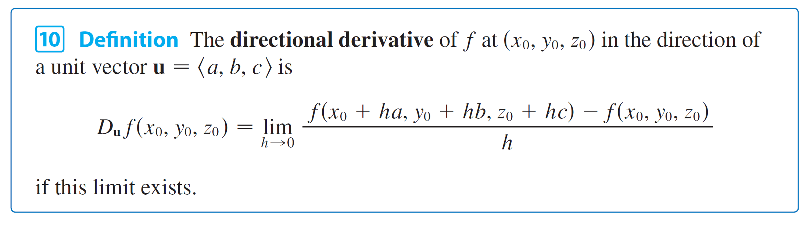
Functions of Three Variables
For functions of three variables we can define directional derivatives in a similar manner.
Again D_{u}f (x, y, z) can be interpreted as the rate of change of the function in the direction of a unit vector u.

Slide 36
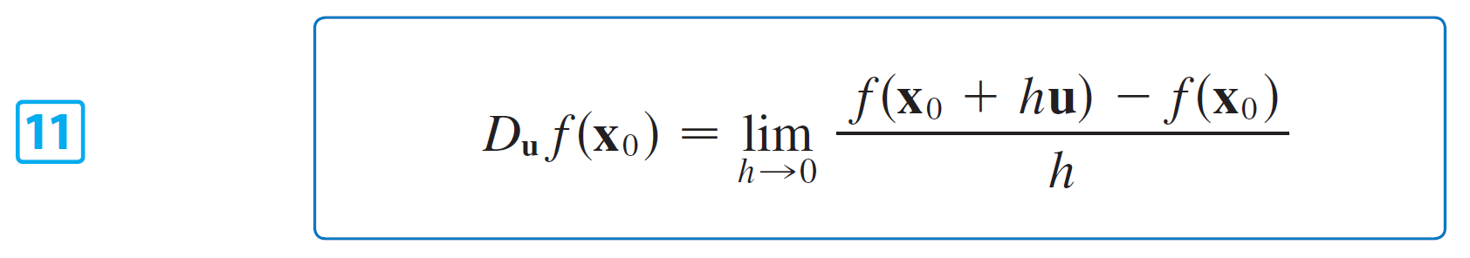
Functions of Three Variables
If we use vector notation, then we can write both definitions (2 and 10) of the directional derivative in the compact form
where x₀ = ⟨x₀, y₀⟩ if n = 2 and x₀ = ⟨x₀, y₀, z₀⟩ if n = 3.
This is reasonable because the vector equation of the line through x₀ in the direction of the vector u is given by x = x₀ + t u and so f (x₀ + hu) represents the value of f at a point on this line.

Slide 37

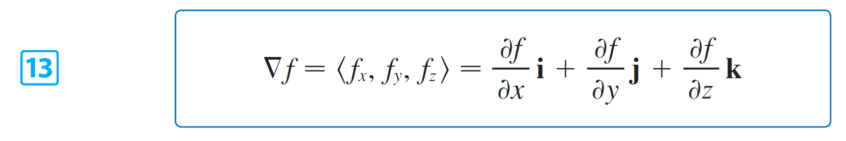
Functions of Three Variables
If f (x, y, z) is differentiable and u = ⟨a, b, c⟩, then
D_{u}f (x, y, z) = f_{x}(x, y, z)a + f_{y}(x, y, z)b + f_{z}(x, y, z)c
For a function f of three variables, the gradient vector, denoted by ∇f or grad f, is
∇f (x, y, z) = ⟨f_{x}(x, y, z), f_{y}(x, y, z), f_{z}(x, y, z)⟩
or, for short,

Slide 38

Functions of Three Variables
Then, just as with functions of two variables, Formula 12 for the directional derivative can be rewritten as

Slide 39
Example 5
If f (x, y, z) = x sin(yz), (a) find the gradient of f and (b) find the directional derivative of f at (1, 3, 0) in the direction of v = i + 2 j – k.
Solution:
(a) The gradient of f is
∇f (x, y, z) = ⟨f_{x}(x, y, z), f_{y}(x, y, z), f_{z}(x, y, z)⟩
= ⟨sin yz, xz cos yz, xy cos yz⟩

Slide 40
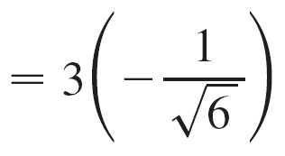
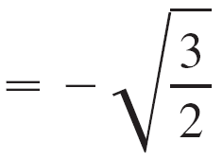
Example 5 – Solution
(b) At (1, 3, 0) we have ∇f (1, 3, 0) = ⟨0, 0, 3⟩.
The unit vector in the direction of v = i + 2 j – k is
Therefore Equation 14 gives
D_{u}f (1, 3, 0) = ∇f (1, 3, 0)  u

Slide 41
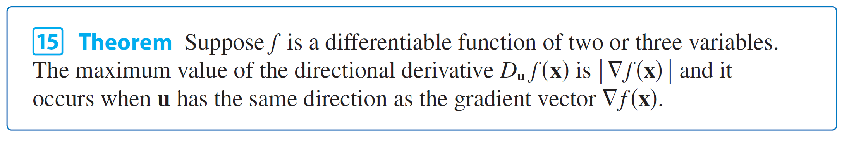
Maximizing the Directional Derivatives
Suppose we have a function f of two or three variables and we consider all possible directional derivatives of f at a given point.
These give the rates of change of f in all possible directions.
We can then ask the questions: In which of these directions does f change fastest and what is the maximum rate of change? The answers are provided by the following theorem.

Slide 42
Example 6
(a) If f (x, y) = xe^{y}, find the rate of change of f at the point P(2, 0) in the direction from P to .
(b) In what direction does f have the maximum rate of change? What is this maximum rate of change?
Solution:
(a) We first compute the gradient vector:
∇f (x, y) = ⟨f_{x}, f_{y}⟩ = ⟨e^{y}, xe^{y}⟩
∇f (2, 0) = ⟨1, 2⟩

Slide 43
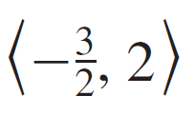

Example 6 – Solution
The unit vector in the direction of = is u = so the rate of change of f in the direction from P to Q is
D_{u}f (2, 0) = ∇f (2, 0)  u
(b) According to Theorem 15, f increases fastest in the direction of the gradient vector ∇f (2, 0) = ⟨1, 2⟩.
The maximum rate of change is
| ∇f (2, 0) | = | ⟨1, 2⟩ | =

Slide 44

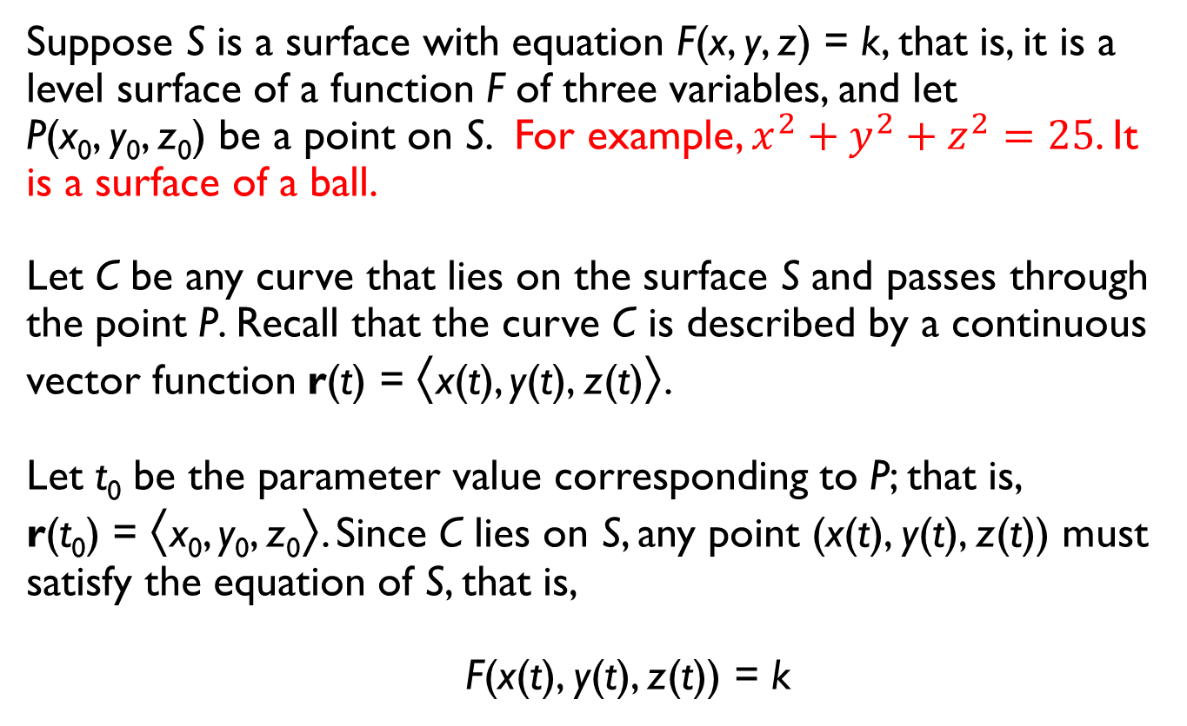
Tangent Planes to Level Surfaces
Suppose S is a surface with equation F(x, y, z) = k, that is, it is a level surface of a function F of three variables, and let P(x₀, y₀, z₀) be a point on S. For example, $x^{2}+y^{2}+z^{2}=25$. It is a surface of a ball.
Let C be any curve that lies on the surface S and passes through the point P. Recall that the curve C is described by a continuous vector function r(t) = ⟨x(t), y(t), z(t)⟩.
Let t₀ be the parameter value corresponding to P; that is, r(t₀) = ⟨x₀, y₀, z₀⟩. Since C lies on S, any point (x(t), y(t), z(t)) must satisfy the equation of S, that is,
F(x(t), y(t), z(t)) = k

Slide 45
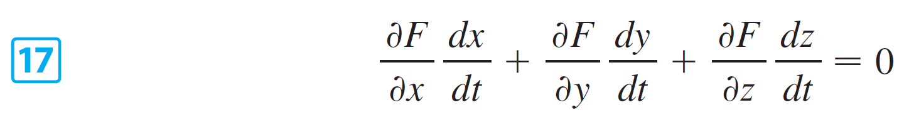
Tangent Planes to Level Surfaces
If x, y, and z are differentiable functions of t and F is also differentiable, then we can use the Chain Rule to differentiate both sides of Equation 16 as follows:
But, since ∇F = ⟨F_{x}, F_{y}, F_{z}⟩ and r′(t) = ⟨x′(t), y′(t), z′(t)⟩, Equation 17 can be written in terms of a dot product as
∇F  r′(t) = 0

Slide 46

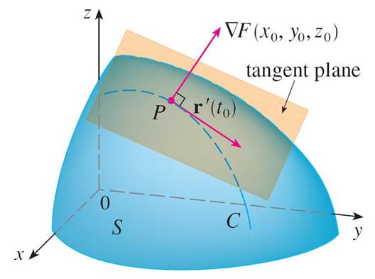
Tangent Planes to Level Surfaces
In particular, when t = t₀ we have r(t₀) = ⟨x₀, y₀, z₀⟩, so
∇F(x₀, y₀, z₀)  r′(t₀) = 0
Equation 18 says that the gradient vector at P, ∇F(x₀, y₀, z₀), is perpendicular to the tangent vector r′(t₀) to any curve C on S that passes through P. (See Figure 9.)
Figure 9

Slide 47
Tangent Planes to Level Surfaces
If ∇F(x₀, y₀, z₀) ≠ 0, it is therefore natural to define the tangent plane to the level surface F(x, y, z) = k at P(x₀, y₀, z₀) as the plane that passes through P and has normal vector ∇F(x₀, y₀, z₀).
Using the standard equation of a plane, we can write the equation of this tangent plane as

Slide 48

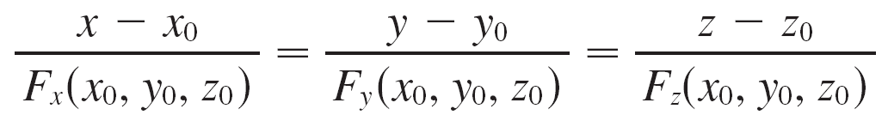
Tangent Planes to Level Surfaces
The normal line to S at P is the line passing through P and perpendicular to the tangent plane.
The direction of the normal line is therefore given by the gradient vector ∇F(x₀, y₀, z₀) and so, its symmetric equations are

Slide 49
Tangent Planes to Level Surfaces
In the special case in which the equation of a surface S is of the form z = f (x, y) (that is, S is the graph of a function f of two variables), we can rewrite the equation as
F(x, y, z) = f (x, y) – z = 0
and regard S as a level surface (with k = 0) of F. Then
F_{x}(x₀, y₀, z₀) = f_{x}(x₀, y₀)
F_{y}(x₀, y₀, z₀) = f_{y}(x₀, y₀)
F_{z}(x₀, y₀, z₀) = –1
so Equation 19 becomes
f_{x}(x₀, y₀)(x – x₀) + f_{y}(x₀, y₀)(y – y₀) – (z – z₀) = 0

Slide 50
Example 8
Find the equations of the tangent plane and normal line at the point (–2, 1, –3) to the ellipsoid
Solution:
The ellipsoid is the level surface (with k = 3) of the function

Slide 51


Example 8 – Solution
Therefore we have
F_{x}(x, y, z) = F_{y}(x, y, z) = 2y F_{z}(x, y, z) =
F_{x}(–2, 1, –3) = –1 F_{y}(–2, 1, –3) = 2 F_{z}(–2, 1, –3) =
Then Equation 19 gives the equation of the tangent plane at (–2, 1, –3) as
–1(x + 2) + 2(y – 1) – (z + 3) = 0
which simplifies to 3x – 6y + 2z + 18 = 0.
By Equation 20, symmetric equations of the normal line are

Slide 52
Significance of the Gradient Vector
We now summarize the ways in which the gradient vector is significant.
We first consider a function f of three variables and a point P(x₀, y₀, z₀) in its domain.
On the one hand, we know from Theorem 15 that the gradient vector ∇f (x₀, y₀, z₀) gives the direction of fastest increase of f.

Slide 53
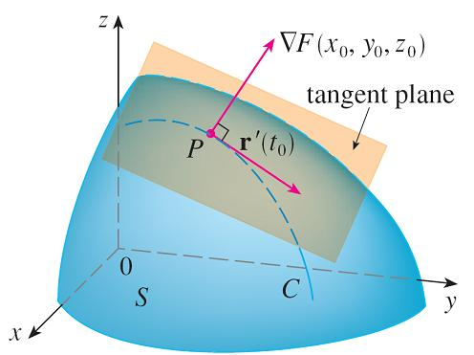
Significance of the Gradient Vector
On the other hand, we know that ∇f (x₀, y₀, z₀) is orthogonal to the level surface S of f through P. (Refer to Figure 9.)
These two properties are quite compatible intuitively because as we move away from P on the level surface S, the value of f does not change at all.
Figure 9

Slide 54
Significance of the Gradient Vector
So it seems reasonable that if we move in the perpendicular direction, we get the maximum increase.
In like manner we consider a function f of two variables and a point P(x₀, y₀) in its domain.
Again the gradient vector ∇f (x₀, y₀) gives the direction of fastest increase of f. Also, by considerations similar to our discussion of tangent planes, it can be shown that ∇f (x₀, y₀) is perpendicular to the level curve f (x, y) = k that passes through P.

Slide 55
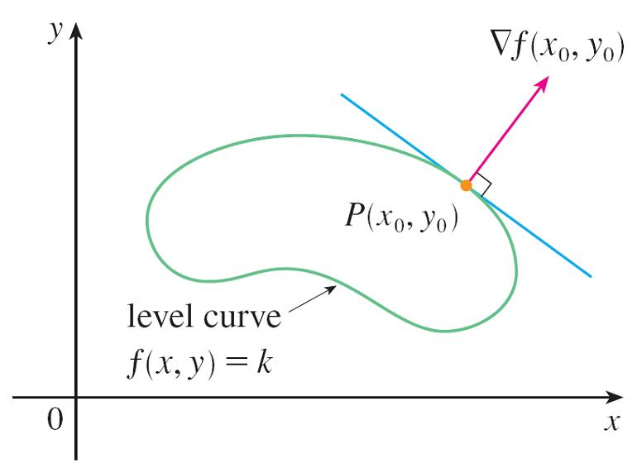
Significance of the Gradient Vector
Again this is intuitively plausible because the values of f remain constant as we move along the curve. (See Figure 11.)
Figure 11

Slide 56
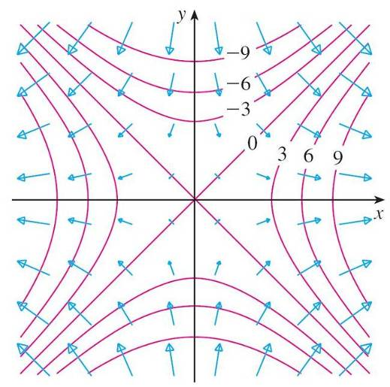
Significance of the Gradient Vector
Computer algebra systems have commands that plot sample gradient vectors.
Each gradient vector ∇f (a, b) is plotted starting at the point (a, b). Figure 13 shows such a plot (called a gradient vector field ) for the function f (x, y) = x² – y² superimposed on a contour map of f.
As expected, the gradient vectors point “uphill” and are perpendicular to the level curves.
Figure 13

